Slide 1







DEV DYNAMOS
AUDIT
MANAGEMENT
Chiranjeev Marwaha (21104083)
Jatin Kharbanda (21104077)
Pratyush Soni (21104043)
Sahil Singh (21104050)
Vaibhav Aswal (21107122)

Slide 2



CONTENT
KEY TOPICS DISCUSSED IN
THIS PRESENTATION
Problem Statement and our approach towards solving it
Our thinking process
Tech Stacks Used
Unique features of our solution
Demo Screenshots of website
Hero of our solution
Additional features that could be added

Slide 3

PROBLEM STATEMENT
Designing a comprehensive web-based application that effectively manages student information incorporating interconnected relational data and the ability to perform CRUD as well as Auditing operations.
OUR SOLUTION
Creating audit logs which can be used for monitoring a system.
Entire log can be regenerated in case of any error in the system.

Slide 4
OUR THINKING PROCESS
1
2
3
4
5
STEP
STEP
STEP
STEP
STEP
Brainstorming
Decide features
Frontend
Backend
Presentation
Read all statements carefully and chose the one which best suited us.
Added multiple features so that website becomes interactive.
Used latest frontend techniques.
Django for API and PostegreSQL for storing data.
Gathered information from the team to present the solution.

Slide 5

TECH STACKS USED
WE USED THE FOLLOWING TECH STACK FOR THE DEVELOPMENT OF OUR SOLUTION :-
Frontend
Backend
Figma
Javascript
Next.Js
Tailwind
Framer Motion
Django
PostgreSQL

Slide 6

UNIQUE FEATURES OF OUR SOLUTION
Efficient memory handling and easy to understand
We are making use of routing technique for efficient memory management.
Latest frontend development techniques
Making use of Next.Js for our frontend makes it less tedious.
Relating PostgreSQL and Django
Creating Api’s for fetching data from frontend.

Slide 7

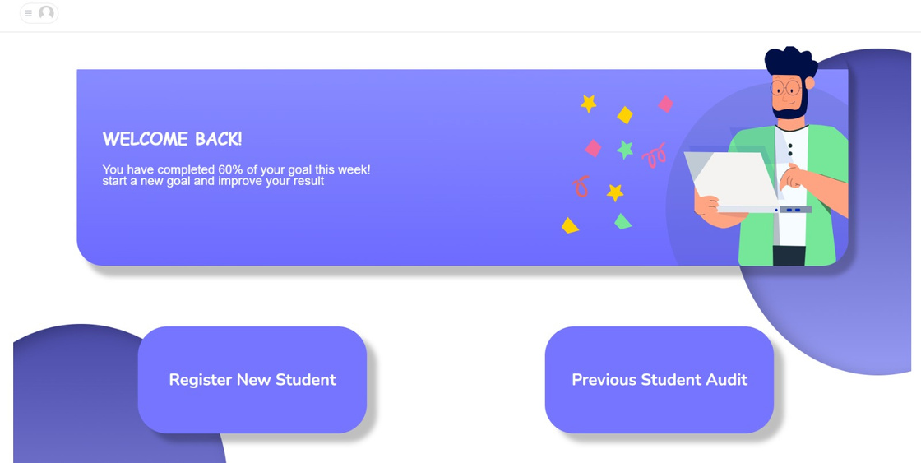
DEMO
Screenshots of Website

Slide 8
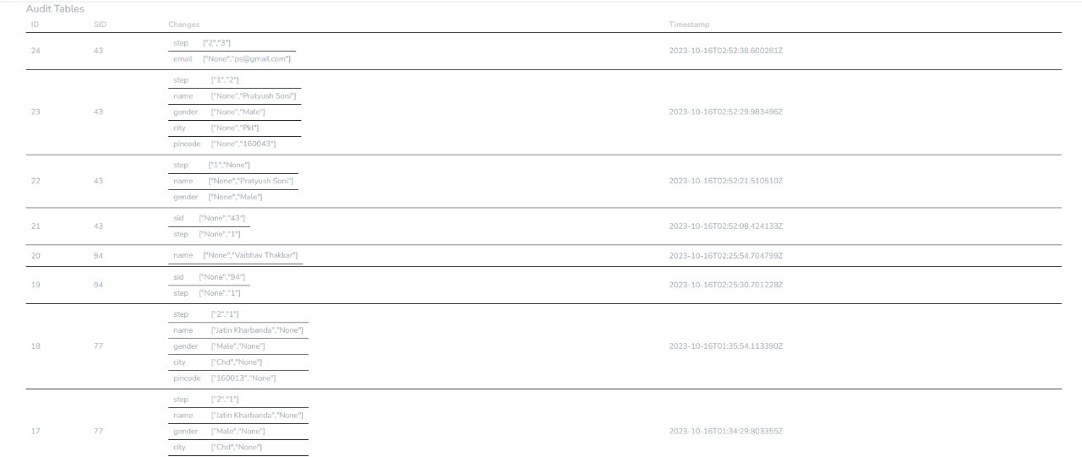
Hero Of Our Solution

Slide 9

Additional Features (that could be added)
Currently our site focuses on admin portal, but in future we can also incorporate a student’s portal.
We can add a Dark/Light theme toggle switch so that it gets easier for the user to access it even in dim light environments.
Currently our site is interactive but not responsive so we can use responsive web design principles through tailwind.
Currently our site gathers data using forms only but in we can directly export data of students using csv files.
Currently our audit details are packed universally, but we can definitely add personalized audit details view according to each user.

Slide 10






THANK YOU FOR YOUR TIME & THIS WONDERFUL OPPORTUNITY

Slide 11

Now we are open for questions?

